Slide 1
GESTURE RECOGNITION
Papanastasiou Nektarios, Prof. Ioannis Pitas
Aristotle University of Thessaloniki
pitas@csd.auth.gr
www.aiia.csd.auth.gr
Version 2.0
Date: 18/1/2021

Slide 2
SUMMARY
What is gesture and the types of gestures. The sensors which are used for capturing gestures and create modalities of dataset.
The applications of the gesture recognition and some of the latest and most important datasets for gesture recognition.
The algorithms that have been developed and the problems that have arisen over the gesture recognition.
The algorithms that have been developed and the problems that have arisen over the gesture recognition.
Systems for spatiotemporal analysis of data. Comparison of CNN models for gesture recognition and a proposed skeleton-based architecture.
The article has references from 16 scientific papers of Computer Vision and their Open Access versions, provided by the Computer Vision Foundation (CVF) and from 5 articles on websites on the internet.

Slide 3
GESTURE RECOGNITION
Introduction
Gesture types
Evolution of Gesture Recognition devices
Applications
Datasets
Algorithms of Gesture Recognition
Problems of Gesture Recognition
3D CNN-Convolutional Neural Networks
3D CNN+LSTM [ConvLSTM]
Deep learning methods for spatiotemporal systems
Comparison of architectures
Skeleton-Based Gesture Recognition
References

Slide 4
Introduction
Gesture recognition is the interpretation of any gesture from a computer through mathematical algorithms.
The aim is the computer to execute commands based on gestures.
It is a form of interaction between a human and a computer.
Gestures can be extensive and comprehensive or small and contained and they can include any type of movement.

Slide 5
GESTURE TYPES

Slide 6
Gesture types (based on the timing)
Online gestures:
Instant interpretation of gestures. They are used to manipulate an object(scaling , rotation).
Offline gestures:
they are implemented after the procedure of the user interaction with the object.

Slide 7
Gesture types (based on the body parts)
Hand Gestures: waving goodbye, showing points…
Head Gestures: nodding, winking…
Body Gestures: kicking, raise knee or elbow…

Slide 8
Gesture types (based on duration)
Static Gesture:
the pose in an instant time, a photo or an image of the position of the body part (showing the thumb…).
Dynamic Gesture :
changeable pose over a small period of time (waving palm…).

Slide 9
EVOLUTION OF GESTURE REVOLUTION DEVICES

Slide 10
Evolution of Gesture Recognition Devices
DATA GLOVES
Gloves that are worn on the hands and measure the position and the movement.
In 1983, the first time that a data glove recognized hand position.
active gloves have a sensor or accelerometer.
passive gloves have colour markers for image identification.

Slide 11
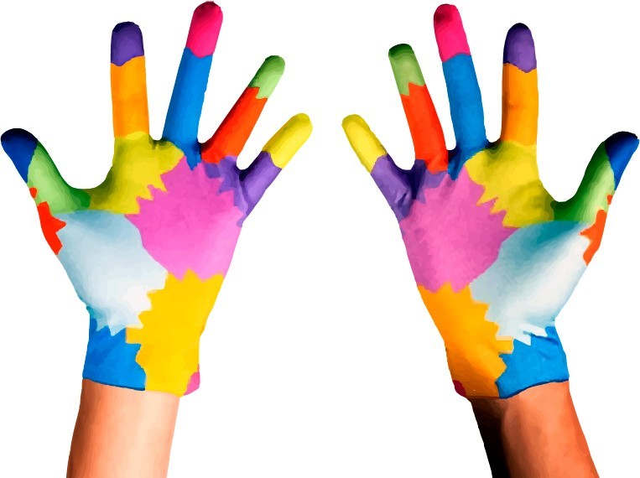
Passive gloves to help differentiate finger position [JES2020]

Slide 12
EMG Electromyography Electrodes
Instead of gloves, wearable bracelets with electromyography sensors which measure the electrical signals from the muscles. EMG has been used for medical diagnosis, control of prosthetics and for the rehabilitation after severe musculoskeletal injuries.

Slide 13
Ultrasound
sonomyography: uses ultrasound images to observe the muscles inside the body on a real-time.
A technique based on Doppler Effect uses ultrasonic frequency signals where a device emits ultrasonic continuous tones.

Slide 14
WiFi
WiFi has the ability to perform gesture recognition even under non line of sight (NLOS). There are already researches based on the received signal strength indicator (RSSI), on the signal flight time indicator (ToF) or on the observation of the channel status information (CSI).

Slide 15
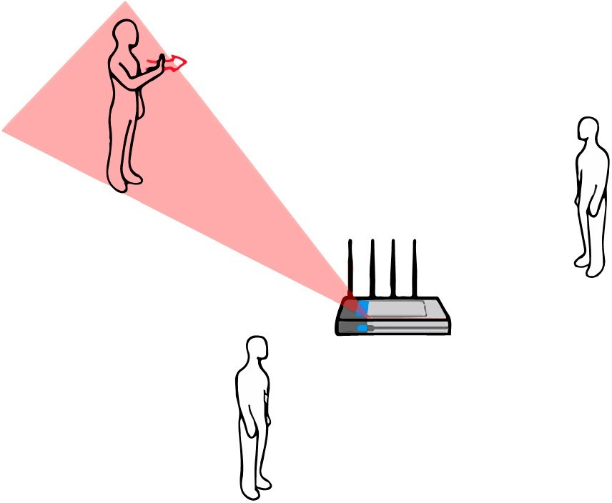
WiFi recognition of different hand positions [JES2020]

Slide 16
RFID Radio Frequency Identification
RFID systems generally consist of ultra-high frequency (UHF) commercial readers, which are capable of detecting labels. Information such as phase changes, can be collected from UHF signals and provide potential possibilities for gesture recognition.

Slide 17
RGB Cameras
Digital cameras capture the light in three main channels of red, green and blue light. The image is saved in an array of pixels, each one obtains the three RGB channels. The object will be detected from the image in a computer-vision algorithm, in which, the order and the intensity of colour of every pixel will provide n information.

Slide 18
Depth Camera
This camera gives depth data which provides a map for the depth in each pixel. In this way, the depth map describes the distance of an object.
The advantage of this data is Provide automatic body part segmentation via skeleton tracking so track and segment hands automatically, providing depth data related specifically to the hands.
Distortions can be easily caused because of the small lense's flaws.

Slide 19
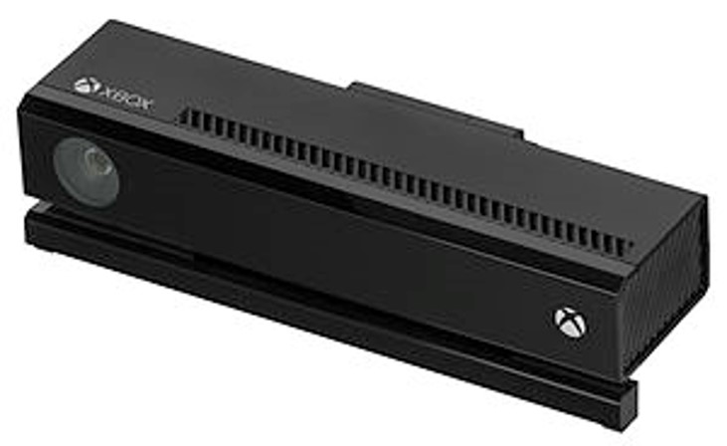
Microsoft Kinect depth Camera

Slide 20
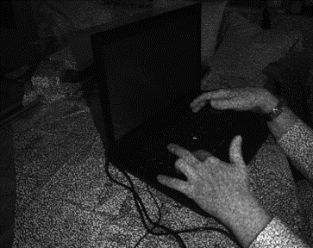
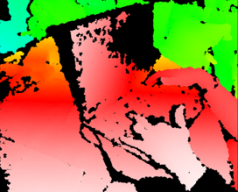
Example of a depth data
infrared image taken by the Kinect infrared
image revisualized into a depth map using color gradients from white (near) to blue (far)

Slide 21
Leap Motion
It is a compact and affordable recognition device, which is capable of 3D tracking forearms, hands and fingers in real time. It contains two infrared cameras, with an angle of 120° and three infrared LEDs. The sensors work within a non-visible spectrum for the human eye, and use sample speeds of up to 200 fps (frames per second), adapting their lighting to detected light.

Slide 22
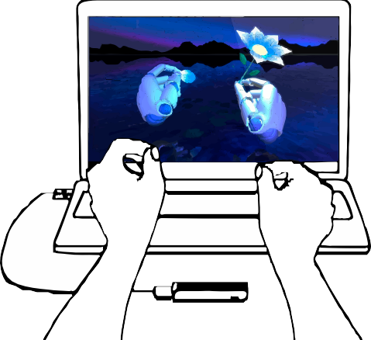
Leap Motion operating mode [JES2020]

Slide 23
VR Virtual Reality
VR-based devices can create interactive spaces for different fields, such as finger tracking. The tracked movements of the user are transformed into arbitrary coordinate systems and data formats, so the VR environment serves as a kind of meta-layer to integrate and simulate different virtual tracking systems.

Slide 24
APPLICATIONS

Slide 25
APPLICATIONS
Sign Language.
Navigating or/and manipulating in virtual environment.
Distance learning.
Understand human behavior in human-computer interaction.
Monitoring devices and machines from a distance.

Slide 26
HUMAN-MACHINE INTERACTION
The interaction between a human and a device can be performed with gesture recognition.
The [ZEN2018] presents a driver–vehicle interaction and the sensor that is used for the getting the depth data is the Camboard Nano one of the types of Time-of-Flight (ToF) sensors.
The control system is applied on a mobile tablet computer which is on the central console of the vehicle.
ToF sensors are able to record hand gestures as depth data input in real time.
Camboard nano sensor provides depth images of resolution 165 × 120 pixel at a frame rate of 90 fps.

Slide 27
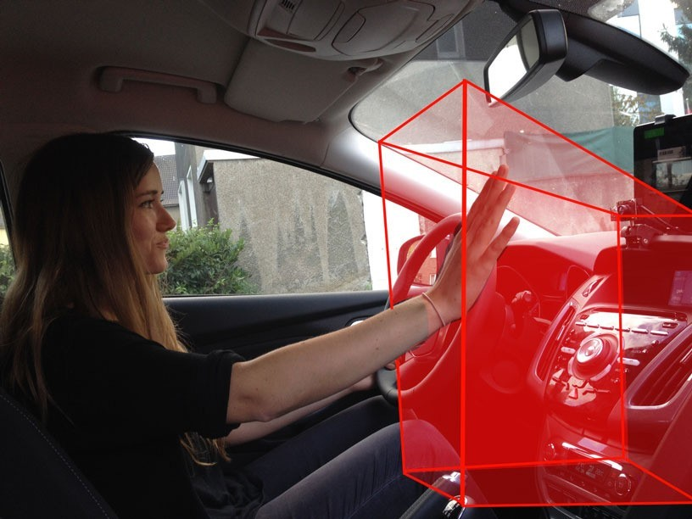
Performing a hand gesture in the detection range of time-of-flight (ToF) sensors (red area) [ZEN2018]

Slide 28
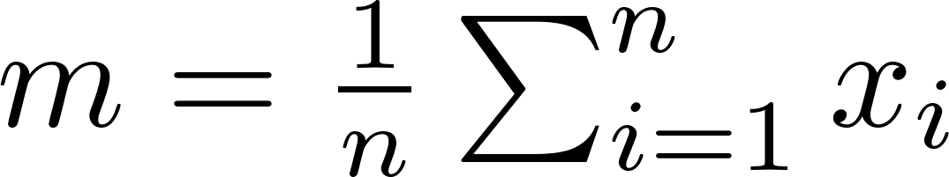
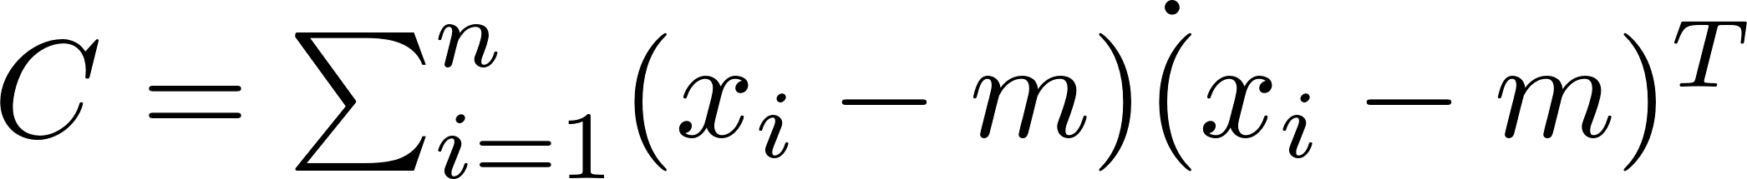
Preprocessing data
The data carries irrelevant information for the hand gesture classification.
PCA (Principal Components Analysis) reduces the dimensions of high-dimensional data and it is used for cropping the data to the part we want to focus on.
The eigenvector equation for the covariance matrix of the depth images estimates the direction of largest variance.
For an n three-dimensional coordinates input vector x, we compute the mean value m:
The estimation of the covariance matrix as scatter matrix C:

Slide 29
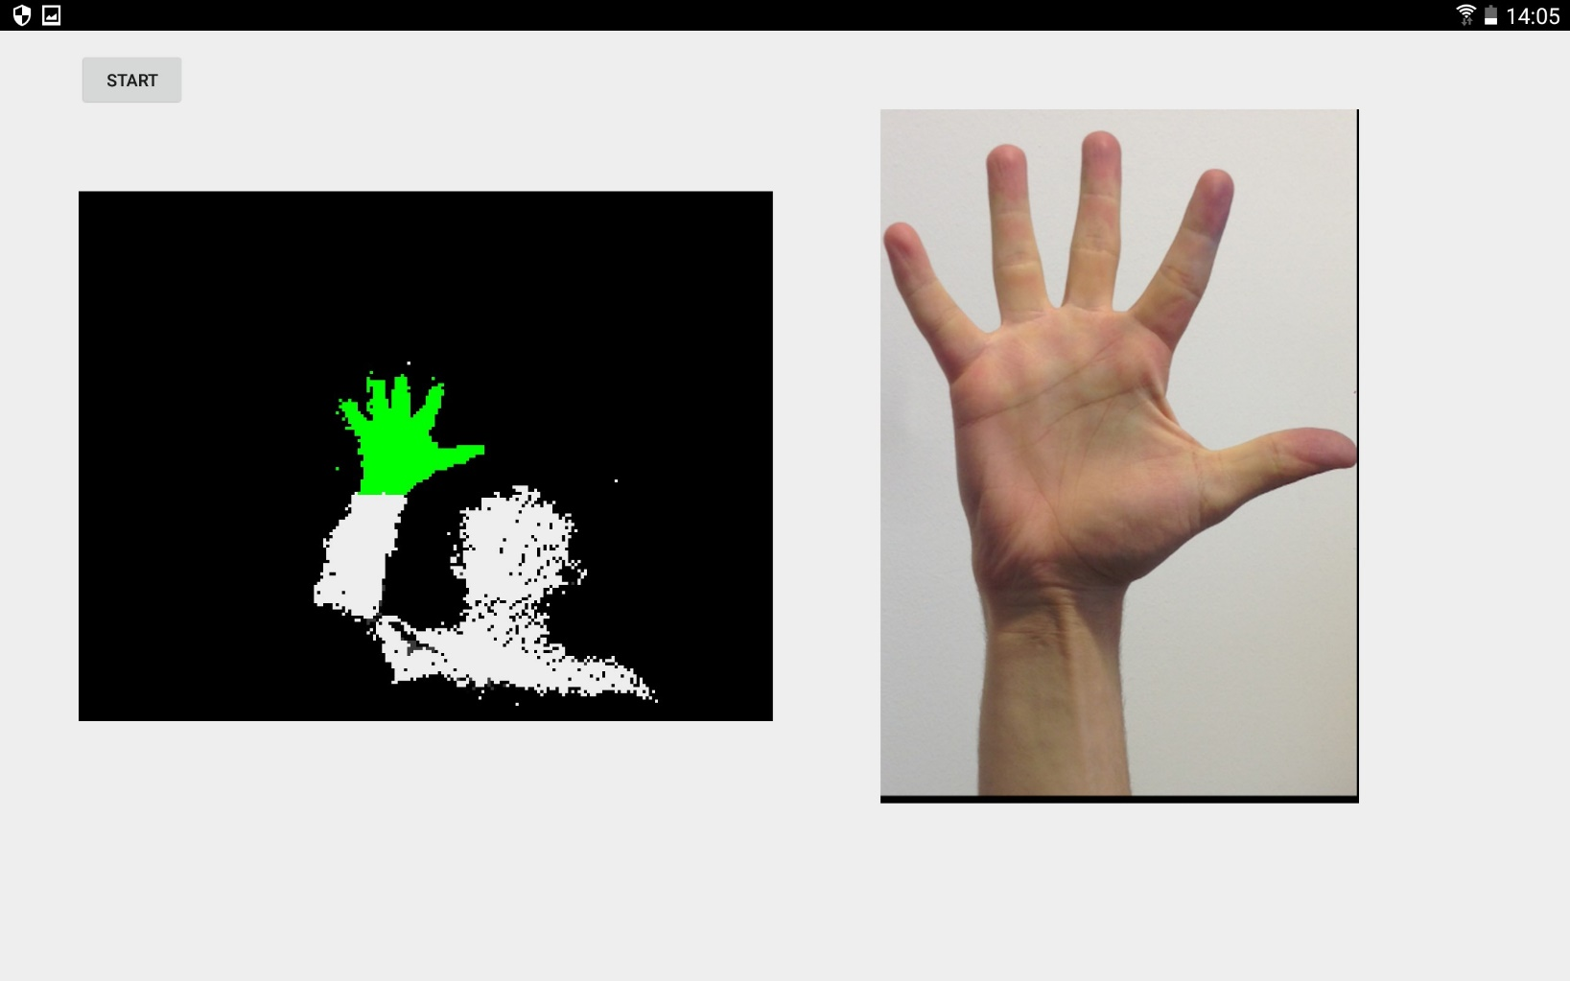
Preprocessing data with PCA the green area (left) remain to identify the correct hand posture class (right) [ZEN2018]

Slide 30
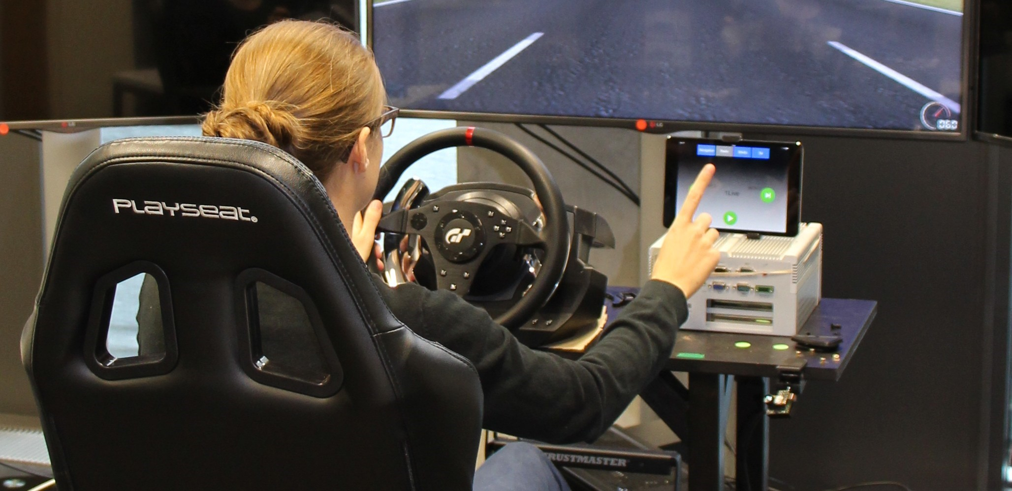
Performing the Lane Change Test while controlling the system with gestures [ZEN2018]

Slide 31
HUMAN-ROBOT INTERACTION
Gesture controlled robots are used in various fields:
In industry(car factories…).
In medicine( remote surgeries with robots…).
In military( armed robotic vehicles…).
In space(articulated hands…).

Slide 32
Robot programming using gestures
The [TSA2016] proposed a high level robot programming method based on body and hand gestures.
The data formed from two devices. The first device is an RGB-d for the body gestures, and the second is leap motion for the hand gestures.
The body gestures control the motion of a robot arm in 6 different directions +/-x, +/-y and +/-z.
The hand gestures are dynamic motions which involve movements of the fingers and they create the same motions as the body gestures.
This method is applied for online interaction with an industrial robot, and it can perform in multi-arm robotic systems, enabling the coordinated motions execution.

Slide 33
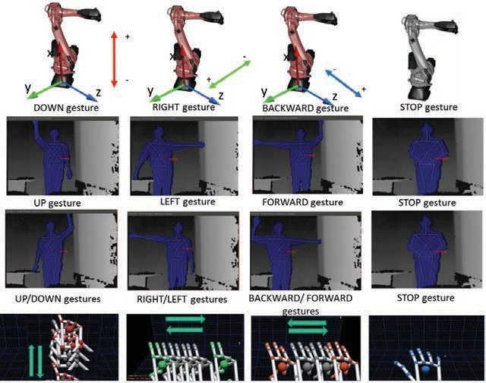
Performing body gestures as commands for robot [TSA2016]

Slide 34
The structure of the system
The two sensors (Kinect and leap motion) are connected to computer.
The computer and the robot create a network through an ethernet cable.
A vocabulary includes body and hand gestures as high level commands for the robot.
The body gestures are interpreted by the Kinect and the model recognizes 18 human skeleton nodes.
Analysis of the nodes ends up to the classification which is based to the vocabulary.
The data from the leap motion sensor is used for the recognition of the hand gestures in the same way.

Slide 35
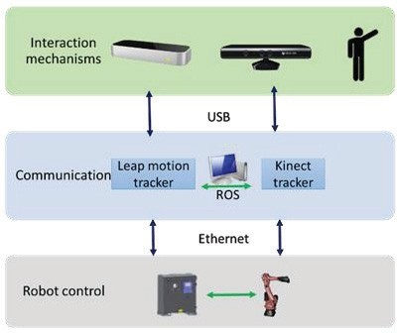
The architecture of the hardware [TSA2016]

Slide 36
UAV-unmanned aerial vehicle
UAV-unmanned aerial vehicle is used in many different purposes:
In photography(aerial photos…).
In military(surveillance…).
In transportation(UAV taxi…).
In delivery(courier services…).
In agriculture(spray for pest and fungal infestations…).

Slide 37
Payload of UAVs (1)
Besides its weight, a UAV can carry additional material such as sensors, cameras, packages for delivery…
Depending on the size and the power of the UAV, different types of sensors can be implemented [AZO]:
Thermal Sensors: detect the heat that radiates from any observed object and create data with images or videos.
Chemical Sensors: detect the chemicals of the environment. The main use of them is for the safety of the workers or generally people in unknown chemical present.
Time of Flight (ToF) Sensors: Depth sensors of the ToF that emit a short infrared light pulse and they measure the time in which the infrared light pulse returns back to the drone.

Slide 38
Payload of UAVs (2)
Distance Sensors:
Light-Pulse Distance Sensing (Laser): A Laser Range Finder (LRF) sends out a laser beam, detects the time that the beam returns after reflecting an object and calculates the distance.
Radio Detection and Ranging: detect the speed and direction of the object in relation to the drone depending on their frequency shift.
Sonar-Pulse Distance Sensing (Ultrasonic): send a sound wave at a specific frequency to an object and detect the time that it returns.
Orientation Sensors:
Accelerometers: sense movement of the drone.
Inertial Measurement Sensors: detect changes of direction.

Slide 39
Payload of UAVs (3)
Some of the most used cameras on drones are:
RGB camera.
RGB-depth camera.
Leap motion camera.
NIR(Near-Infrared) camera.
SWIR (short-wave infrared) camera.
LIDAR (Light Detection And Ranging) camera.

Slide 40
HUMAN-DRONE INTERACTION
The [HUA2019] proposed model performs a remote control of drones by gesture recognition.
The structure of the model has 5 modules:
A scene-understanding module.
A pilot detection module.
An action detection and recognition module.
A gesture recognition module.
A joint reason and control module.

Slide 41
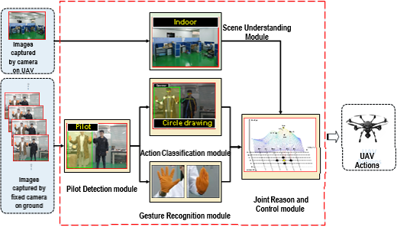
The structure of the model [HUA2019]

Slide 42
Action Recognition Module (1)
The description of human motion can be recognized by using the key points extracted from the bodies as the input features with the GCN-Graph Convolutional Network.
S represent the sampling function used to enumerate the neighbors of location x.
W represent the weight function which provides a weight vector for computing the inner product with the sampled input feature vectors within the convolutional kernel.
h and w are the pixels in the kernel (rows and columns).

Slide 43
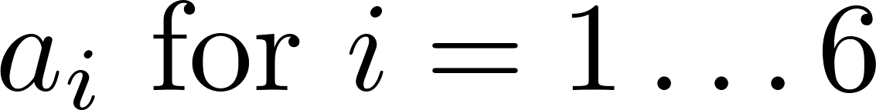
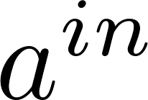
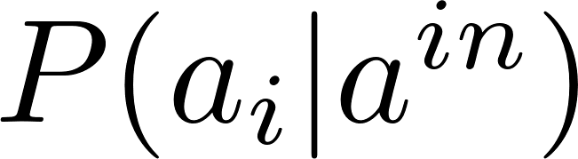

Action Recognition Module (2)
There are 6 kinds of actions for the control the action of UAV
The computation of the probability of an input action to be classified as action with a softmax function through M successive frames is:
If the maximum output value of this function is over a predefined threshold, then the input action will be considered as the corresponding action.

Slide 44
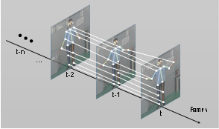
the ST-GCN spatial temporal graph of a skeleton sequence which is used to classify the action of a human [HUA2019]

Slide 45
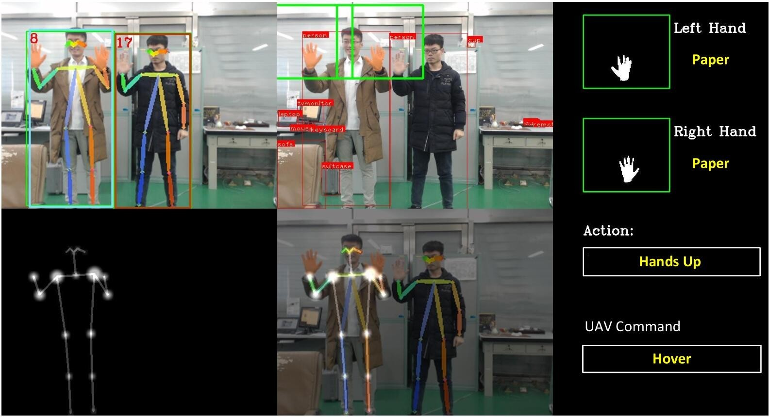
Simulation experimental result of the system when two person perform similar actions [HUA2019]

Slide 46
DATASETS

Slide 47
Datasets for Gesture Recognition
Recently, deep learning models are the state of the art in the methodology of gesture recognition. Different modalities of data inputs(such as skeleton joints information, human body shape, RGB, optical flow, and depth frames) are combined for the training of these models, therefore there is a significant amount of datasets which had been created based on gesture recognition.

Slide 48
DVS128 Gesture Dataset
The CVPR 2017 paper “A Low Power, Fully Event-Based Gesture Recognition System.” describes a real time gesture Recognition model which used this dataset for training.
The dataset contains 11 hand gestures from 29 subjects under 3 illumination conditions.
Each trial has two files: an data file contains the DVS128 events, and an annotation file contains the start and stop times of each gesture.
Filenames identify the subject and illumination condition in each trial.
[DVS]

Slide 49
Hand Gesture Recognition Using 3D Skeletal Dataset
There are 14 hand gestures in this dataset performed in two ways: with only one finger and with the whole hand.
There are 2800 sequences, every gesture is performed between 1 and 10 times by 28 participants in both of the ways.
The gesture, the number of fingers that was used, the performer and the trial, were all labelled in every sequence.
Each frame of sequences contains the coordinates of 22 joints both in the 2D depth image space and in the 3D world space forming a full hand skeleton.
The skeletons were captured at 30 frames per second.
[SKD]

Slide 50
HGM-4
The HGM-4 dataset is built for hand gesture recognition and contains 4,160 color images (1280 × 700 pixels) of 26 hand gestures captured by 4 cameras at different position.
The images were taken indoor at different positions and the background was removed semi-automatically.
This dataset can be used for studying the hand-gesture recognition problems in the perception of multiple views.
Every image from 4 cameras were combined to be in the training set or in the testing set with all possible combination.
[GM4]

Slide 51
EgoGesture Dataset
The dataset contains 2,081 RGB-D videos, 24,161 gesture samples and 2,953,224 frames from 50 distinct subjects.
There are 83 classes of static or dynamic gestures performed on interaction with wearable devices.
The videos was made in 6 different scenes, 4 indoor and 2 outdoor. There are videos where the gestures were performed by people while they were walking.
The two-modality videos, RGB and depth modules, are recorded in a resolution of 640ⅹ480 pixel with 30 fps.
The gestures performed randomly, thus the videos can be applied to evaluate gesture detection in sequence.
The volume of the data is about 46G of RGB-D videos and about 32G of images(320x240).
[EGO2018]

Slide 52
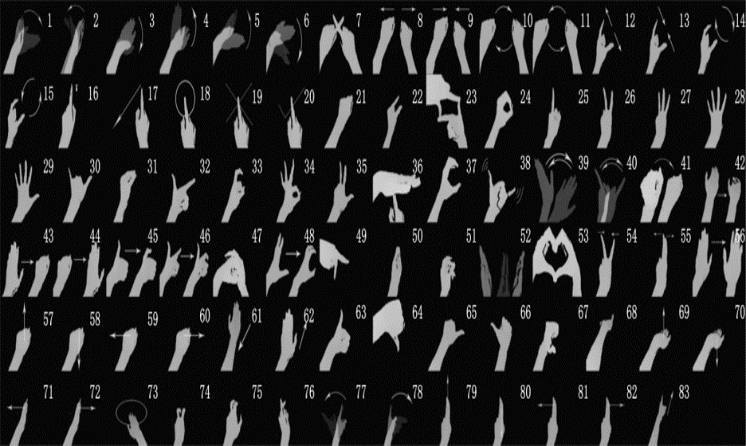
The 83 classes of the EgoGesture dataset [EGO2018]

Slide 53
putEMG and putEMG-Force
These are databases of surface electromyographic activity recorded from forearm.
Signals were recorded from 24 electrodes fixed around subject right forearm using 3 elastic bands, creating a 3×8 matrix, data is sampled at 200 Hz rate.
The dataset includes 7 active gestures (like hand flexion, extension, etc.) + idle and a set of trials with isometric contractions.
They are used for the implementation of algorithms for gesture recognition and for grasp force recognition.
For gesture execution ground-truth, a HD Camera providing an RGB feed and a depth camera with a close view of subject’s hand were used. Videos and depth images are provided alongside the EMG data.
[PEM]

Slide 54
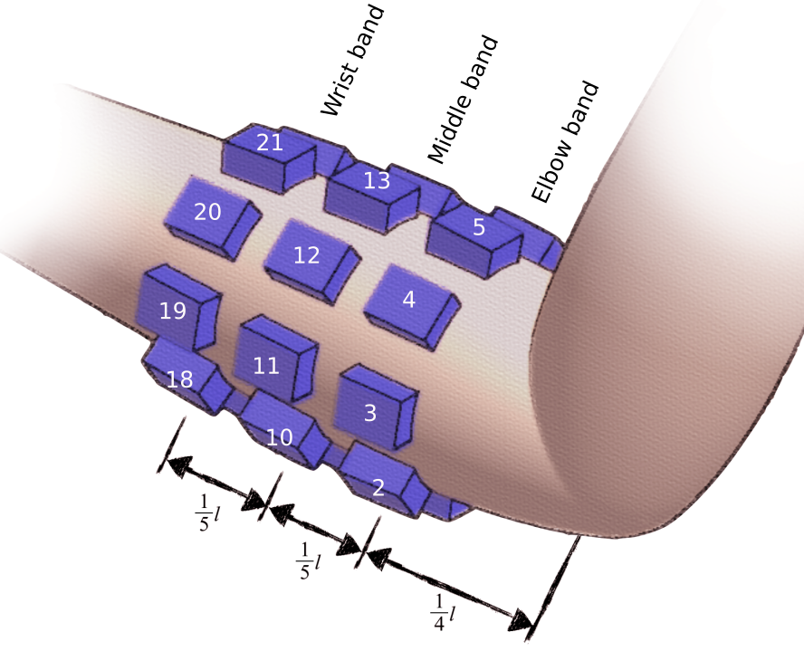
Signals are recorded from 24 electrodes fixed around subject right forearm pattern: elbow band [1-8], middle band [9-16], wrist band [17-24] [PEM]

Slide 55
HMD Gesture Dataset
This dataset contains about 360,000 image pairs for gesture recognition and were taken from 31 participants and 30 different environment.
The images hand gestures for AR and VR head-mounted display systems and they are captured from a stereo monochrome fisheye pair mounted in front of a typical HMD system.
The dataset contains 8 gesture classes and for each image pair, it is provided a gesture class label and bounding box location of hands.
Images also may contain cluttered background and exacting lighting conditions.
[HMG]

Slide 56
WLASL
The dataset, WLASL, is a large-scale signer-independent ASL dataset, 34.404 videos of 3.126 glosses
The meta data has annotations about:
Temporal boundary: the indication of the start and end frames of a sign.
Body Bounding-box: the reduction of the noises with the use of YOLOv3 for person detection, to identify the body of the signers in videos.
Signer Diversity: there are inter-signer variations in the input data (example: signer appearance and signing paces).
Dialect Variation Annotation: the dialect variations of signs contains different sign primitives, such as hand-shapes and motions, have been annotated for each gloss.
[DON2020]

Slide 57
The 20BN-jester Dataset V1
The video data is split into parts of 1 GB and the number of the videos is 148.092 and their total size is 22.8 GB.
The videos for the training set are 118.562, for the testing set 14.743, and for the validation set 14.787.
The JPG images from the videos were extracted at 12 frames per seconds and there are 27 classes of the dataset.
The subjects performed hand gestures in front of a laptop camera or webcam.
[JES]

Slide 58
UAV-GESTURE
The data was collected on an place located in the middle of a wheat field from a rotorcraft UAV (3DR Solo) in slow and low-altitude flight
the videos have a resolution HD (1920 × 1080) at 25 fps.
In these videos, the subject is located in the middle of the frame and execute 13 gestures, each of the gesture is performed five to ten times.
Thirteen body joints are annotated in 37151 frames, namely ankles, knees, hip-joint, wrists, elbows, shoulders and head and each annotation has also the gesture class, the subject identity and the bounding box.
The bounding box is created by adding a margin to the minimum and maximum coordinates of joint annotations in both x and y directions.
[ASA2018]

Slide 59
ALGORITHMS OF GESTURE RECOGNITION

Slide 60
Algorithms of Gesture Recognition
3D model-based algorithms: an object is interpreted as a collection of vertices and lines in the 3D mesh version.
Skeletal-based algorithms: models the object but with fewer parameters than the volumetric version.
Appearance-based models: derive the parameters directly from the images or videos using a template database.
Electromyography-based models: classify the body movement with data of electrical signals produced by muscles.

Slide 61
Tree of algorithms
Spatial gesture Models
3D Model- based
Skeletal
Volumetric
NURBS
Primitives
Super-quadrics
Appearance –based Models
Image sequences
Deformable 2D templates

Slide 62
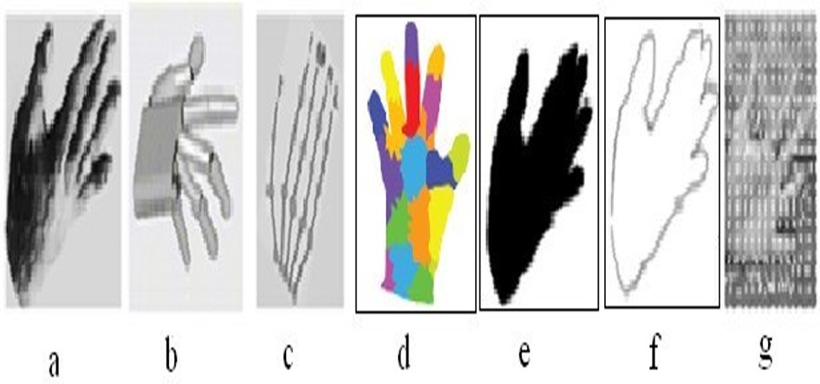
Various hand modeling methods to represent hand posture [27]. (a) 3D volumetric model. (b) 3D geometric model. (c) 3D Skeleton model. (d) Colored marker based model. (e) Non-geometric shape model (Binary silhouette [11]). (f) 2D deformable template model (contour [11]). (g) Motion based model [RAF2012]

Slide 63
PROBLEMS OF GESTURE RECOGNITION

Slide 64
Problems of Gesture Recognition
Lighting condition: the changes of the light in the image make the extraction of the skin region more difficult.
Rotation: there is problem when the subject that performs the gesture is rotated in any direction.
Scaling: the pose of the body or the hand have different sizes in the image of the gesture.
Interpretation: the changes of the position of the subject in different images, may give false representation of the features.
Background: when there is complex background with different objects that confuse the detection and lead to misclassification.

Slide 65
3D CNN-CONVOLUTIONAL NEURAL NETWORKS

Slide 66
3D CNN-Convolutional Neural Network
3D CNN architectures can be applied in a sequence of frames as inputs thus they are used for video analysis.
2D CNNs make use of the spatial dependencies and 3D CNNs make use of both the spatial and temporal relations of the frames.
Real-time recognition systems require the use of detection of the gesture and classification on the continuous stream of images.
Many layers are the same as in the 2D CNN but all the calculations are in the 3 dimensions.
Rectified linear unit (ReLU) is one of the most common activation function, avoiding in this way the problems of the vanishing and exploding gradient descent.

Slide 67
Convolution in a 3D CNN architecture [RAO2020]
INPUT DATA 21x21x21
*
[Stride 3]
KERNEL 5x5x5
=
FEATURE MAP 6x6x6

Slide 68
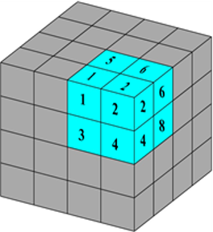
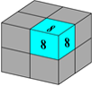
Pooling in 3 dimensions [RAO2020]
Before max pooling
After max pooling

Slide 69
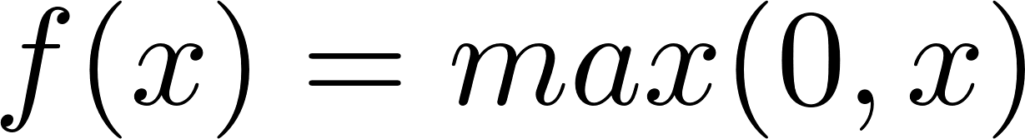
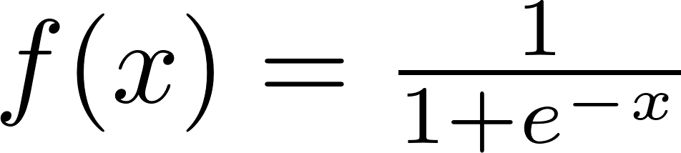
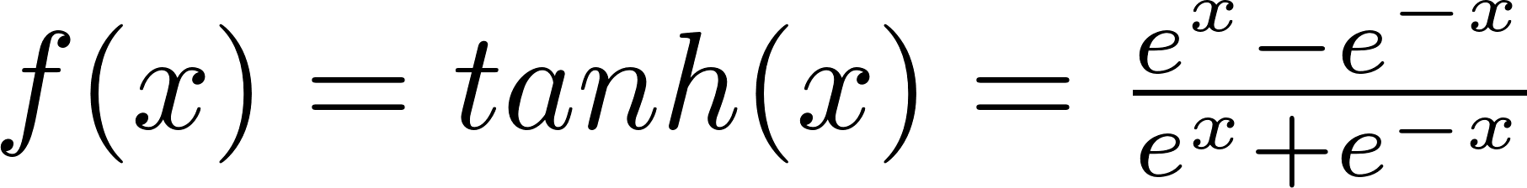
ACTIVATION FUNCTIONS
The activation layers give nonlinearity in a CNN.
The most used activation functions are:
ReLU -Rectified Linear Unit
Sigmoid function
tanh function

Slide 70
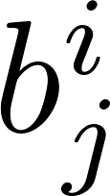
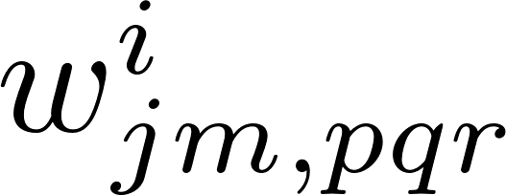
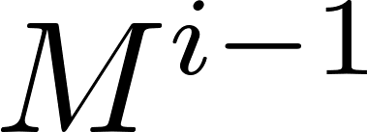
ReLU
Mathematical expression of the output value γ at position (x, y, z) on jth feature map in ith 3D convolutional layer can be written as:
is the common bias for j-th feature map. is the (p, q, r)-th value of the 3D filter for j-th feature map at i-th layer associated with the m-th feature map in the (i-1)th layer. is the number of feature maps at (i-1)th layer. P^{i} , Q^{i} and R^{i} denotes the size of the 3D filter at i-th layer.

Slide 71
Hyperparameters of the 3D CNN system
The number and the size of the filters.
The size of the batch input.
The learning rate.
The number of the hidden layers.
The number of the Fully Connected layers and their neurons.
The type of the classifier.
The type and the size of the pooling.

Slide 72
3D CNN+LSTM ConvLSTM

Slide 73
3D CNN+LSTM ConvLSTM
The [NOO2019] proposed model combines 3D convolution neural network connected with long short-term memory (LSTM) as a feature extraction model.
Multimodal data, RGB and Depth data are incorporated as the input model.
The use of the Finite State Machine (FSM) control is to reduce some gesture flows and to border the recognition classes.
Attention is focused on the hand by removing the background and unnecessary pixels.
The global side of the hand gesture recognition is analyzed. The input data includes the whole handshape instead of using finger feature for classification.

Slide 74
The dataset of the system
The datasets contains 2162 videos of users when performing 24 gestures, 13 static and 11 dynamic.
Each gesture sequence consists of a three-second length dynamic gesture which contains 120 frames.
The sensor for the data was The Real Sense SR300 depth camera thus the dataset includes the RGB and Depth data.
To extract the hand, given the whole RGB image I_{r} , and depth image I_{d} , fixed distance dt to remove the long distance background and minimum distance min of I_{d} as the range filter was defined. Let I_{rb} be the RGB image and I_{db} be Depth image, after background removal. Based on the range [min, dt] the average distance of a point d_{av} in I_{db} can be calculated as follows:

Slide 75
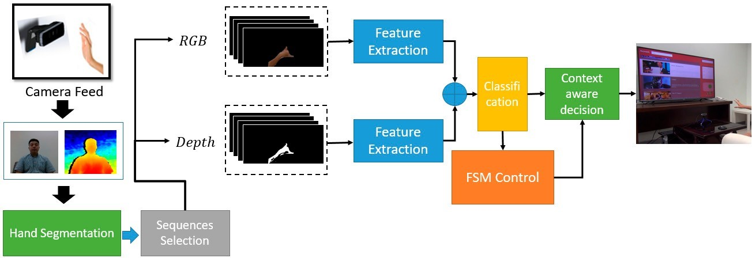
The architecture of the proposed system [NOO2019]

Slide 76
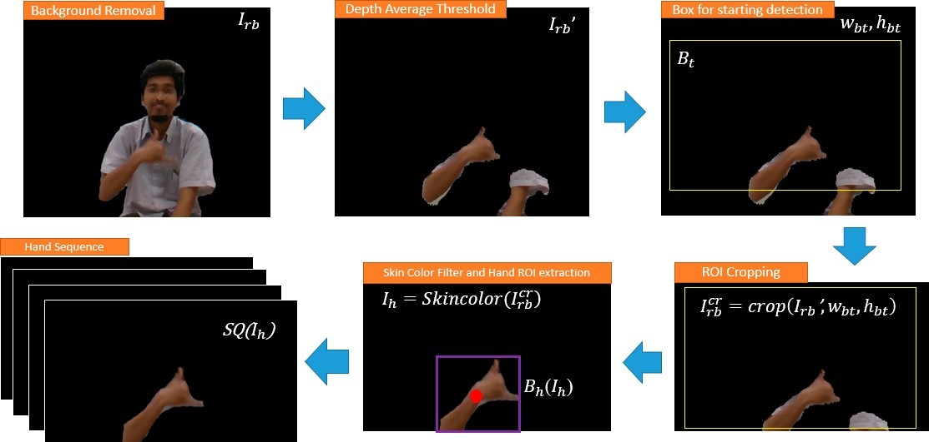
The preprocessing step of hand extraction based on the average depth threshold [NOO2019]

Slide 77
The multimodal architecture
the architecture of the model consists of 3DCNN layers, one stack LSTM layer and, a fully connected layer followed by the softmax layer.
Batch normalization was utilized to allow the model to use much higher learning rates.
The kernel size of each Conv3D layer is 3 × 3 × 3, the stride and padding are sizes of 1 × 1 × 1.
Each Conv3D layer is followed by a batch normalization layer, a ReLU layer and a 3D Max Pooling layer with a pool size of 3 × 3 × 3.
Features are extracted from the 3DCNN architecture then fed into the one stack of LSTM with 256 sizes of the unit.
Several dropout layers were added in every section with the value of 0.5.

Slide 78
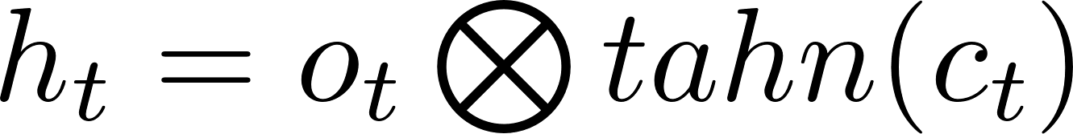
Gates of LSTM
Input gate:
Forget gate:
Output gate:
Cell gate:
Memory:
Output activation(hidden state):
{ t= time }

Slide 79
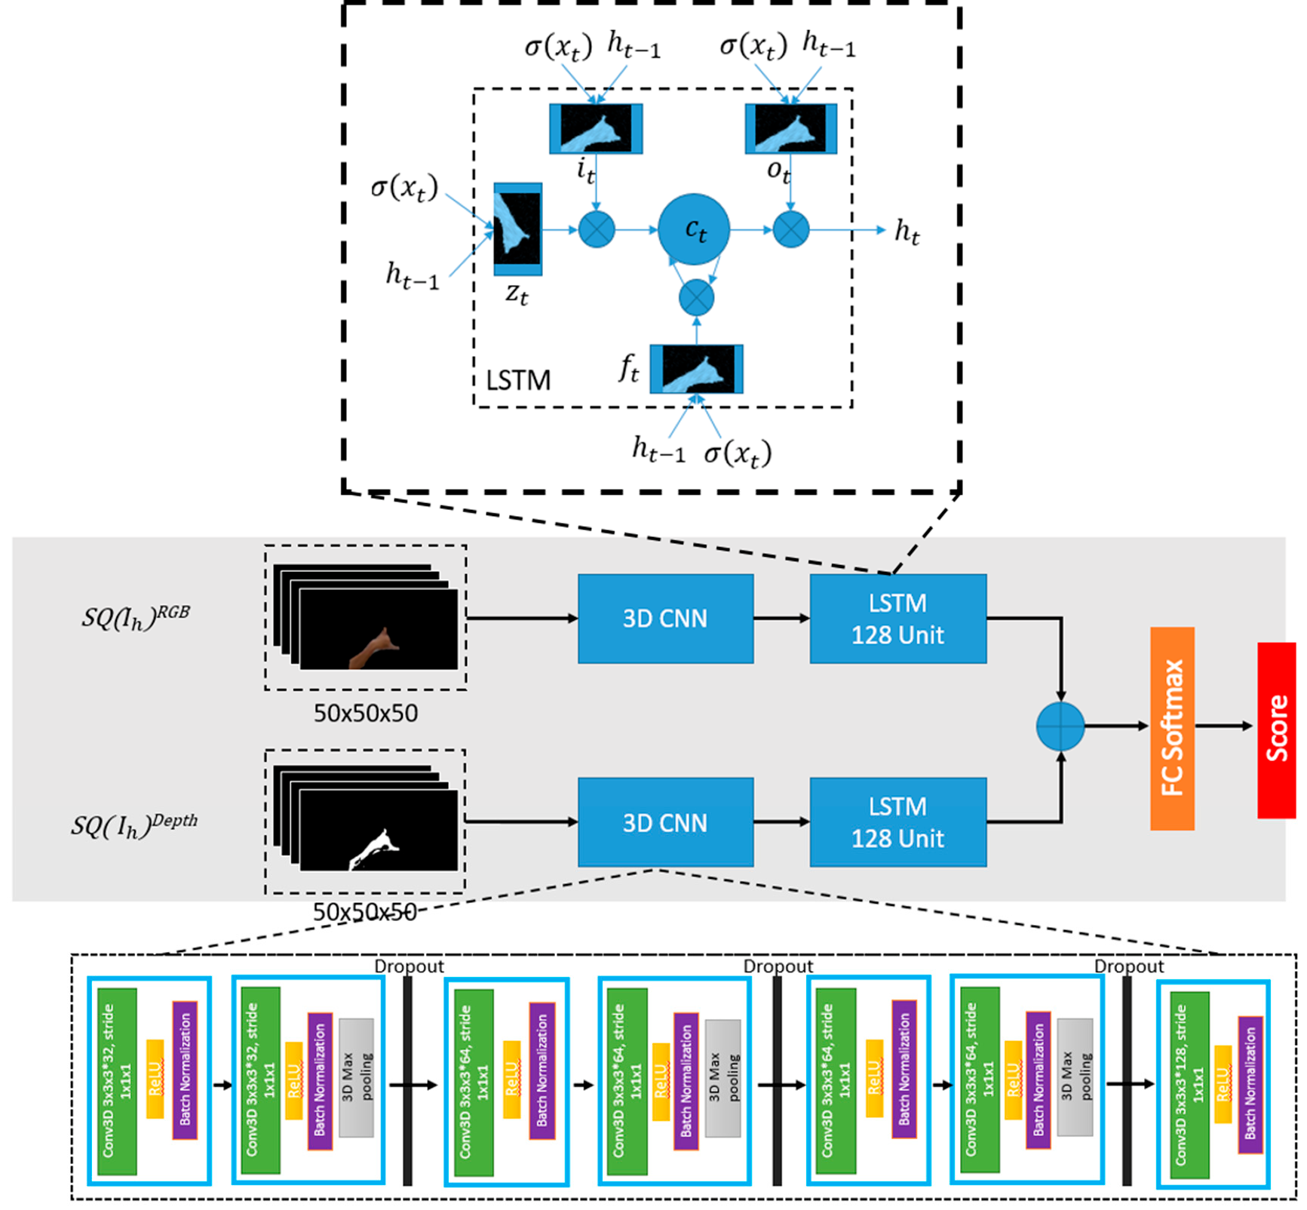
The proposed 3DCNN + LSTM architecture [NOO2019]

Slide 80
Handling the data
Making fusion of both depth and RGB as the input data might produce a better result rather than using one data stream input.
There are three kinds of multimodal types according to their fusion levels:
Early fusion: 4 channels,3 channels RGB+1 channel depth, fused before the input to the 3D CNN layers.
Middle fusion: the output of the separated 3D CNN layers, one from the RGB and the other from the Depth, are fused for the input to LSTM layer.
Late fusion: in the same way, the fusion takes place after the LSTM layer and before Fully Connected layer.

Slide 81
[NOO2019]
Early fusion+Depth+RGB hand only, accuracy rate 95,8%
Middle fusion+Depth+RGB hand only, accuracy rate 95,1%
Late fusion+Depth+RGB hand only, accuracy rate 97,6%

Slide 82
Context-Aware Neural Network
One way to increase the recognition rate in the system is to let the model recognize smaller gesture class.
In a Context-Aware recognition control system recognition class was limited in every context of the application.
The Finite State Machine (FSM) as a controller machine connects with the Deep learning model and gives restrictions to the softmax decision probability by handling the weight in the last layer.
The system in a current context or state communicates with FSM to decide which gesture should be ignored.
The pre-defined weights to the last layer’s node that connects to the class which is ignored by the FSM are applied, thus just the correct gestures are accepted.

Slide 83
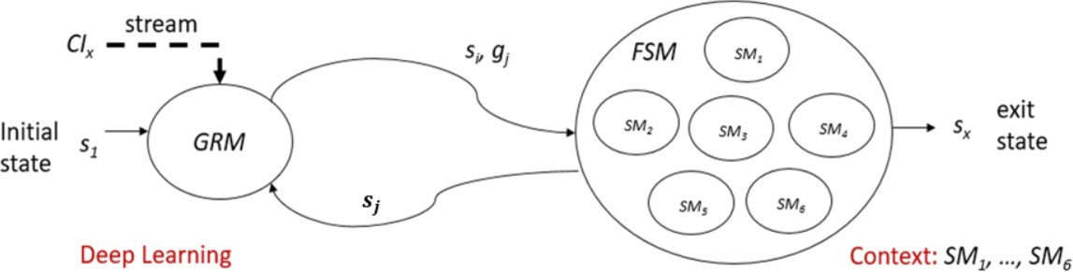
the FSM model controller with GRM (Gesture Recognition Machine) [NOO2019]

Slide 84
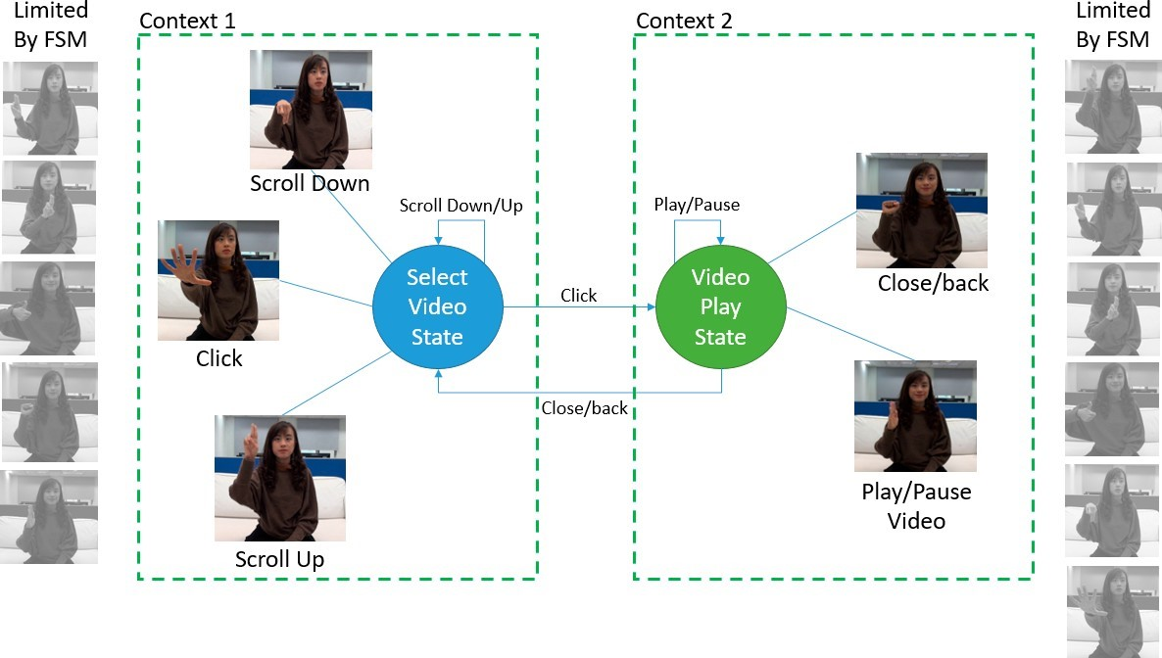
An example of two contexts in FSM model [NOO2019]

Slide 85
DEEP LEARNING METHODS FOR SPATIOTEMPORAL SYSTEMS

Slide 86
Deep learning methods for spatiotemporal systems
According to [EGO2018] there are 4 ways of modelling for spatiotemporal systems:
The 2D ConvNets extract features of one frame. The classifiers are trained to predict the labels of videos based on the frame features.
The 3D ConvNets extract features of video clips. Afterwards, they aggregate the clip features into video descriptors.
The usage of recurrent neural networks (RNN) to handle the temporal frames sequences is based on convolutional features.
Formatting a video as one or multiple compact frames and classify it with a neural network.

Slide 87
Evaluation of models
In [EGO2018], deep learning models are being compared using the dataset EgoGesture.
The data splits into training set (60%) 1.239 videos, in validation set (20%) 411 videos and in testing set (20%) sets 431 videos.
For classification, we segment the video sequences is segmented into isolated gesture samples based on the first and the last frames, which are annotated in advance.
The learning task is to predict the labels of the class for each gesture sample.

Slide 88
The deep learning models
VGG16 is a 2D convolutional neural network with 13 convolutional and 3 fully-connected layers.
C3D is a 3D CNN with eight 3D convolutional layers, one 2D pooling layers, four 3D pooling layers and three fully-connected layers.
C3D+hand mask: a hand segmentation based C3D method since the depth camera eliminate most of the background information and the depth frame is considered as a hand mask.
C3D+LSTM+RSTTM: a C3D augmented model with a recurrent spatiotemporal transform module (RSTTM).
VGG16+LSTM a single-layer LSTM with 256 hidden units after the first fully-connected layer of VGG16 .
IDMM+CaffeNet handles spatial and temporal data of a video into an image called improved depth motion map (IDMM)and in this way there can be the use of 2D ConvNets for classification.

Slide 89
The parameters of the models
Stochastic Gradient Descent (SGD) is used for optimization.
learning rate: VGG16 (0.001), C3D (0.003), VGG16+LSTM (0.0001).
the step size of learning rate decay: VGG16 (5), C3D (5), VGG16+LSTM (10).
Batch size: VGG16(60),C3D(20),VGG16+LSTM (20).

Slide 90
Gesture Classification Accuracy of the models with EGOGESTURE Dataset [EGO2018]
METHOD | RGB | DEPTH | RGB-D
IDMM+CaffeNet | - | 0,664 | -
VGG16 softmax | 0,572 | 0,579 | 0,612
VGG16 fc6 | 0,625 | 0,623 | 0,665
VGG16+LSTM softmax | 0,673 | 0,690 | 0,725
VGG16+LSTM lstm7 | 0,747 | 0,777 | 0,814
C3D fc6, 8 frames | 0,817 | 0,844 | 0,865
C3D softmax, 16 frames | 0,851 | 0,868 | 0,887
C3D fc6, 16 frames | 0,864 | 0,881 | 0,897
C3D+HandMask | - | - | 0,872
C3D+LSTM+RSTTM | 0,893 | 0,906 | 0,922

Slide 91
CS: cross subject setting, when the training set and the testing set are from different subjects Classification accuracy with or without CS [EGO2018]
Method | Modality | Accuracy without CS | Accuracy with CS | Variance
VGG16 fc6 | RGB | 0,667 | 0,625 | 0,042
VGG16+LSTM lstm7 | RGB | 0,764 | 0,689 | 0,075
C3D fc6, 16 frames | RGB | 0,892 | 0,864 | 0,028
VGG16 fc6 | depth | 0,647 | 0,623 | 0,024
VGG16+LSTM lstm7 | depth | 0,801 | 0,732 | 0,069
C3D fc6, 16 frames | depth | 0,907 | 0,881 | 0,026
VGG16 fc6 | RGB-D | 0,697 | 0,665 | 0,32
VGG16+LSTM lstm7 | RGB-D | 0,826 | 0,753 | 0,73
C3D fc6, 16 frames | RGB-D | 0,922 | 0,897 | 0,025

Slide 92
COMPARISON OF ARCHITECTURES

Slide 93
Comparison Of architectures
The [DON2020] shows a study of comparing models which were trained with WLASL dataset
2D CNN+RNN: RNN are used for the temporal relations and 2D CNN for the spatial features of the frames.
3D CNN can be applied for both the spatial and temporal relationship between the frames.
Pose based models: use RNNs to model the pose sequences for analyzing the movements.
Temporal Graph Convolution Networks: (TGCN) models the spatiotemporal dependencies of the pose sequence.

Slide 94
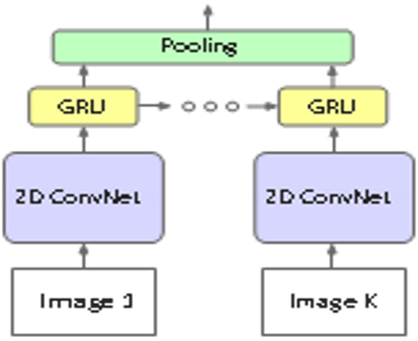
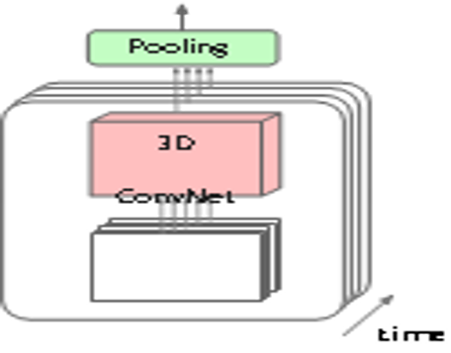
[DON2020]
2D Conv. RNN
3D CNN

Slide 95
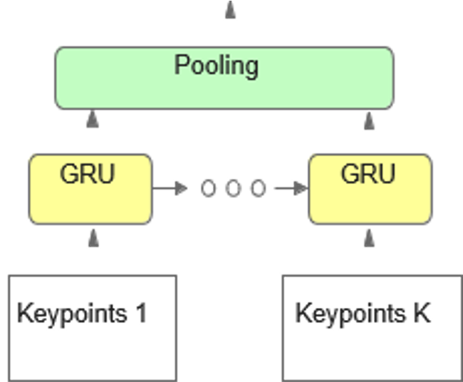
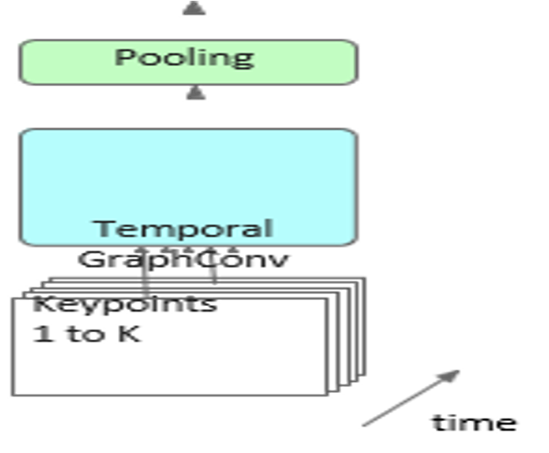
the keypoints are the joints of human bodies [DON2020]
Pose RNN
Pose TGCN

Slide 96

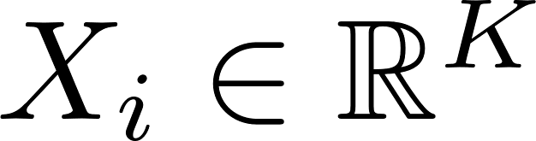
Pose Based Temporal Graph Neural Networks(1)
In the Temporal Graph Convolution Networks (TGCN), the input pose sequence where N= frames and are the 2D keypoints in K dimensions.
encodes the body movements as a holistic representation of the trajectories of body keypoints.
In this way the dependencies among the joints of the human body are represented in a graph network.
A residual graph convolutional block stacks two graph convolutional layers.

Slide 97

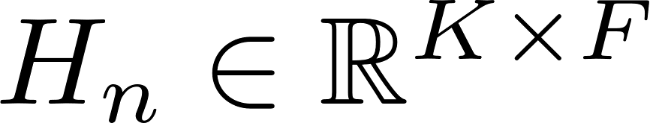

Pose Based Temporal Graph Neural Networks(2)
a human body is represented as a fully-connected graph with K vertices and the edges in the graph as a weighted adjacency matrix:
In a deep graph convolutional network, the n-th graph layer is a function G_{n} that take as input features a matrix:
F is the feature dimension output by its previous layer.
The set of trainable weights:
a graph convolutional layer is expressed as:
where An is a trainable adjacency matrix for n-th layer and σ(·) denotes the activation function tanh(·)

Slide 98
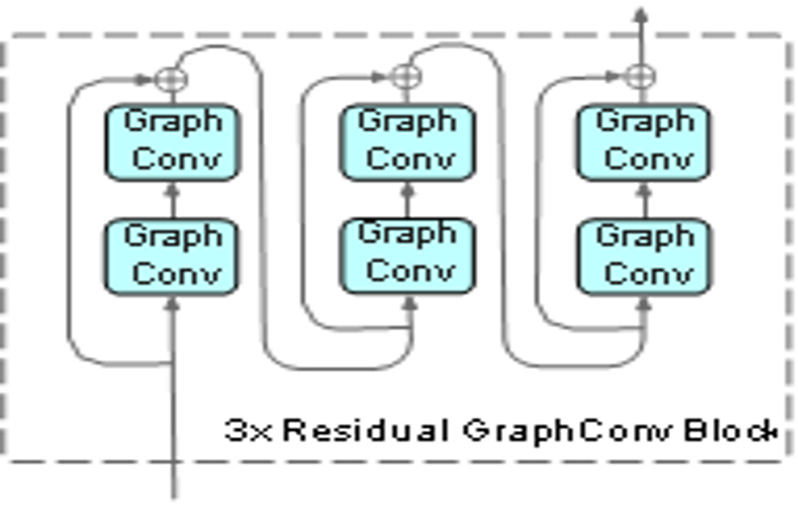
Residual Graph Convolution Block [DON2020]

Slide 99
top-10 accuracy rates by each model on WLASL subsets with different number of glosses [DON2020]
Method | WLASL 100 | WLASL 300 | WLASL 1000 | WLASL 2000
Pose GRU | 0,856 | 0,760 | 0,701 | 0,613
Pose TGCN | 0,876 | 0,796 | 0,719 | 0,622
VGG+GRU | 0,639 | 0,610 | 0,493 | 0,325
3D CNN | 0,899 | 0,869 | 0,843 | 0,663

Slide 100
Top-10 accuracy rates of 3D CNN and Pose-TGCN with different training set (rows) and testing set (columns) on WLASL subsets [DON2020]
TRAINING SET/TESTING SET | WLASL100 |  | WLASL300 |  | WLASL1000 |  | WLASL2000
 | 3D CNN | TGCN | 3D CNN | TGCN | 3D CNN | TGCN | 3D CNN | TGCN
WLASL100 | 0,899 | 0,876 | - | - | - | - | - | -
WLASL300 | 0,883 | 0,814 | 0,869 | 0,796 | - | - | - | -
WLASL1000 | 0,852 | 0,775 | 0,862 | 0,742 | 0,843 | 0,719 | - | -
WLASL2000 | 0,720 | 0,678 | 0,711 | 0,654 | 0,673 | 0,645 | 0,663 | 0,622

Slide 101
SKELETON-BASED GESTURE RECOGNITION

Slide 102
Skeleton-Based Gesture Recognition
The [LIU2020] proposed architecture is built for a skeleton-based Gesture recognition and its approach is that the gesture is a sequence of complexly composite movements.
The innovation of this architecture is that it is combined of two model: one applied on the hand posture variations and the other on the hand movements.
HPEV (3D hand posture evolution volume) is the model applied on the posture variations and HMM (2D hand movement map) model captures holistic movements.
The HPEV integrates spatiotemporal information of hand postures with a 3D CNN, and on the other hand, the HMM uses a 2D CNN model to manipulate hand movement features.

Slide 103
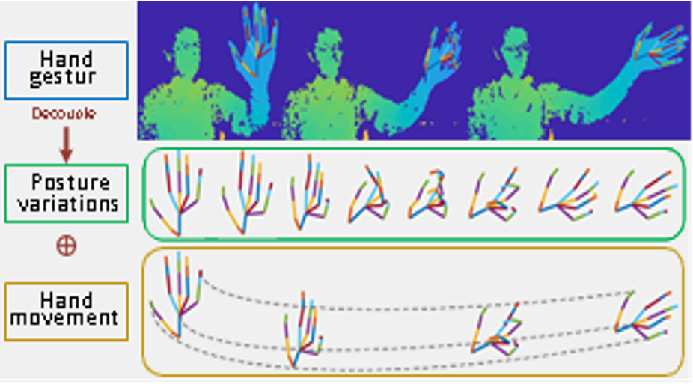
Hand gesture separated into hand posture variations and hand movements [LIU2020]

Slide 104
FRPV -Fingertip Relative Position Vector
FRPV describes finger motion precisely the relative positions of four fingers and thumb of each frame construct it.
For frame t, the four relative positions are concatenated as a vector u_{t} as follows:
where p(0,t) is the coordinate of thumb of the t-th frame, and p(I,t), p(M,t), p(R,t) and p(L,t) are the coordinates of index fingertip, middle fingertip, ring fingertip and little fingertip at frame t respectively.
The FRPV is the concatenation of all the u_{t} of each frame [N= number of frames]:

Slide 105
Architecture of the system(1)
The system consists two main streams and each of them extracts a vector of the features that has built for: HPEV-Net and HMM-Net.
HPEV-Net is applied for the hand movement map and uses a 3D CNN for the low-level features with the size of the kernel 7x3x3 and afterwards there is a stack of four bottleneck modules [KAI2016] for the high level features.
In every CNN layer is used batch normalization and the activation function is RELU. Also, the max pooling layers are 4x2x2.
The output channels of the four bottleneck modules are 128, 128, 256 and 512.
The output of the last bottleneck after global average pooling ends into a feature vector.
The Fingertip Relative Position Vector (FRPV), is applied to describe movements of the fingers, because the restrictions on the resolution make very difficult the encoding of these movements.

Slide 106
Architecture of the system(2)
The output of FRPV goes to the next fully connected layer with Batch Normalization and ReLU activation.
In the same stream, the outputs of HPEV and FRPV, are concatenated and there is a classification of the hand gesture sequences with a softmax algorithm.
On the other stream, Hand Movements Map (HMM), uses a 2D CNN for the for the motion of the hand.
HMM-Net is based on the Hierarchical Co-occurrence Network (HCN) the [CHA2018 ] proposed network, to extract features.
In the same way like the HPEV-Net, there is a stack of four bottleneck modules.
The output channels of the four bottleneck modules are 128, 128, 256 and 512.
The output of the last bottleneck after global average pooling ends into a feature vector.

Slide 107
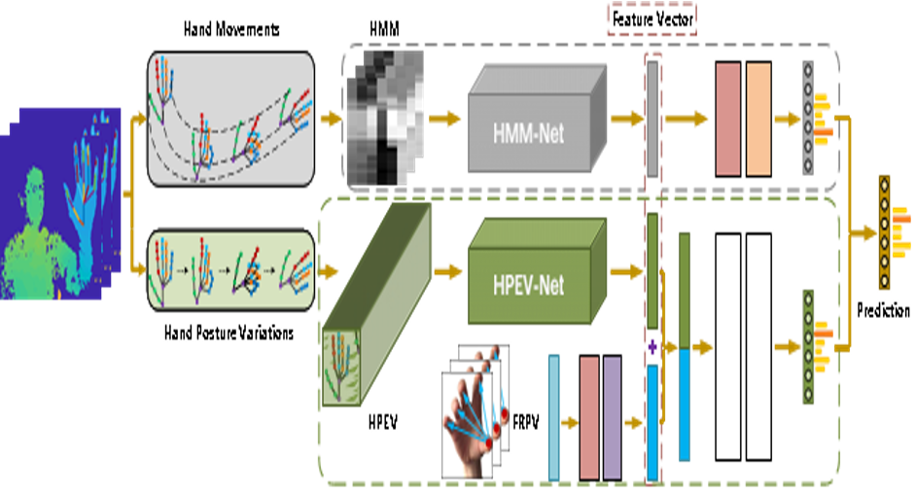
The two Neural Networks HPEV-Net+HMM-Net [LIU2020]

Slide 108
Datasets for analysis
SHREC’17 Track: This dataset [QUE2017] contains 14 gestures. They are performed twice: with one finger and with the whole hand. It includes 2800 sequences, 1960 for the training set and 840 for testing set.
DHG-14/28: The dataset [HAZ2016] comprises 14 gestures with 2800 sequences. The DHG-14/28 and the SHREC’17 Track datasets have the same hand joints and the same data collection method.
FPHA: The last dataset [GUI2018] provides dynamic hand sequences. It includes 1175 action had sequences, with 45 categories handling 26 different objects in 3 scenarios. It has one less hand joint from the SHREC’17 Track dataset. The training set (600 sequences) and testing set (575 sequences) have almost the same percentage of data.

Slide 109
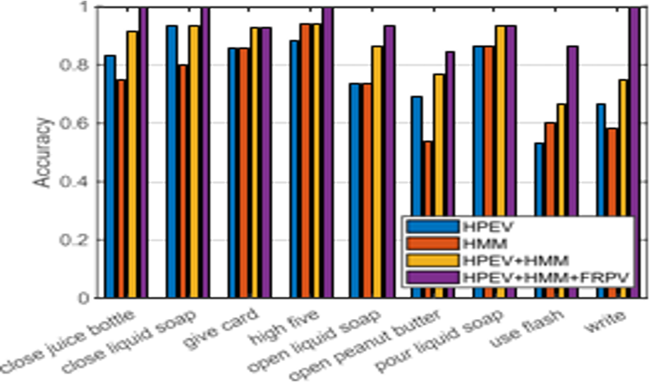
Gesture recognition accuracy rates using different input combinations on FPHA dataset [LIU2020]

Slide 110
Gesture Recognition accuracy rates for different input combinations on SHREC’17 Track and FPHA dataset. 14G:14 gestures, 28G:28 gestures [LIU2020]
Method | SHREK |  | FPHA
 | 14G | 28G
HPEV | 0,734 | 0,714 | 0,770
HMM | 0,927 | 0,866 | 0,677
FRPV | 0,628 | 0,588 | 0,664
HPEV+HMM | 0,944 | 0,902 | 0,829
HPEV+HMM+FRPV | 0,948 | 0,922 | 0,909

Slide 111
Gesture recognition comparison of some of the latest proposed models with SHREC’17 dataset 14G:14 gestures, 28G:28 gestures [LIU2020]
METHOD | ACCURACY 14G | ACCURACY 28G
HON4D [OMA2013] | 0,785 | 0,740
SoCJ+Direction+Rotation [SME2017] | 0,869 | 0,842
SoCJ+HoHD+HoWR [HAZ2016] | 0,882 | 0,819
Two-stream 3D CNN [JUA2018] | 0,834 | 0,774
Res-TCN [JIN2018] | 0,911 | 0,873
STA-Res-TCN [JIN2018] | 0,936 | 0,907
ST-GCN [YAN2018] | 0,927 | 0,877
ST-TS-HGR-NET [XUA2019] | 0,942 | 0,894
DG-STA [YUX2019] | 0,944 | 0,907
HPEV+HMM+FRPV | 0,948 | 0,922

Slide 112
References
[NOO2019] Noorkholis Luthfil Hakim, Timothy K. Shih, Sandeli Priyanwada Kasthuri Arachchi, Wisnu Aditya, Yi-Cheng Chen and Chih-Yang Lin “Dynamic Hand Gesture Recognition Using 3DCNN and LSTM with FSM Context-Aware Model”.
[RAF2012] Rafiqul Zaman Khan and Noor Adnan Ibraheem “COMPARATIVE STUDY OF HAND GESTURE RECOGNITION SYSTEM”.
[JES2020] Jesús Galván-Ruiz, Carlos M. Travieso-González , Acaymo Tejera-Fettmilch, Alejandro Pinan-Roescher, Luis Esteban-Hernández and Luis Domínguez-Quintana “Perspective and Evolution of Gesture Recognition for Sign Language: A Review”.
[DVS] https://research.ibm.com/dvsgesture/
[SKD] https://www.kaggle.com/c/odhgdata/data?select=infos_test.csv
[JES] https://20bn.com/datasets/jester/v1
[PEM] https://biolab.put.poznan.pl/putemg-dataset/
[HMG] https://sites.google.com/view/hmd-gesture-dataset/

Slide 113
References
[ASA2018] Asanka G Perera, Yee Wei Law, and Javaan Chahl “UAV-GESTURE: A Dataset for UAV Control and Gesture Recognition”.
[EGO] http://www.nlpr.ia.ac.cn/iva/yfzhang/datasets/egogesture.html
[GM4] https://data.mendeley.com/datasets/jzy8zngkbg/4
[RAO2020] Chengping Rao, Yang Liu “Three dimensional convolutional neural network (3D-CNN) for heterogeneous material homogenization”.
[EGO2018] Yifan Zhang, Congqi Cao, Jian Cheng, and Hanqing Lu “EgoGesture: A New Dataset and Benchmark for Egocentric Hand Gesture Recognition”.
[DON2020] Dongxu Li, Cristian Rodriguez Opazo, Xin Yu, Hongdong Li “Word-level Deep Sign Language Recognition from Video: A New Large-scale Dataset and Methods Comparison”.
[LIU2020] Jianbo Liu, Yongcheng Liu, Ying Wang, Veronique Prine, Shiming Xiang, Chunhong Pan “Decoupled Representation Learning for Skeleton-Based Gesture Recognition”.

Slide 114
References
[CHA2018] Chao Li, Qiaoyong Zhong, Di Xie, Shiliang Pu. “Co- occurrence feature learning from skeleton data for action recognition and detection with hierarchical aggregation”.
[QUE2017] Quentin De Smedt, Hazem Wannous, Jean-Philippe Vande- borre, Joris Guerry, Bertrand Le Saux, and David Filliat. “Shrec’17 track: 3d hand gesture recognition using a depth and skeletal dataset”.
[HAZ2016] Quentin De Smedt, Hazem Wannous, and Jean-Philippe Van- deborre “Skeleton-based dynamic hand gesture recognition”.
[GUI2018] Guillermo Garcia-Hernando, Shanxin Yuan, Seungryul Baek, and Tae-Kyun Kim “First-person hand action bench- mark with rgb-d videos and 3d hand pose annotations”.
[OMA2013] Omar Oreifej and Zicheng Liu. Hon4d “Histogram of oriented 4d normals for activity recognition from depth sequences”.
[SME2017] Quentin De Smedt “Dynamic hand gesture recognition-From traditional handcrafted to recent deep learning approaches”.

Slide 115
References
[JUA2018] Juanhui Tu, Mengyuan Liu, and Hanying Liu “Skeleton- based human action recognition using spatial temporal 3d convolutional neural networks”.
[JIN2018] Jingxuan Hou, Guijin Wang, Xinghao Chen, Jing-Hao Xue, Rui Zhu, Huazhong Yang “Spatial-temporal attention res-tcn for skeleton-based dynamic hand gesture recognition”.
[YAN2018] Sijie Yan, Yuanjun Xiong, Dahua Lin “Spatial temporal graph convolutional networks for skeleton-based action recognition”.
[XUA2019] Xuan Son Nguyen, Luc Brun, Olivier Le´zoray, and Se´bastien Bougleux “A neural network based on spd manifold learning for skeleton-based hand gesture recognition”.
[YUX2019] Yuxiao Chen, Long Zhao, Xi Peng, Jianbo Yuan, and Dimitris N Metaxas “Construct dynamic graphs for hand gesture recognition via spatial-temporal attention”.
[KAI2016] Kaiming He, Xiangyu Zhang, Shaoqing Ren, and Jian Sun “Deep residual learning for image recognition”.

Slide 116
References
[ZEN2018] Nico Zengeler , Thomas Kopinski and Uwe Handmann “Hand Gesture Recognition in Automotive Human–Machine Interaction Using Depth Cameras”
[TSA2016] Panagiota Tsarouchi, Athanasios Athanasatos, Sotiris Makris, Xenofon Chatzigeorgiou, George Chryssolouris “High level robot programming using body and hand gestures”
[HUA2019] Bo Chen, Chunsheng Hua, Decai Li, Yuqing He and Jianda Han “Intelligent Human–UAV Interaction System with Joint Cross-Validation over Action–Gesture Recognition and Scene Understanding”
[AZO] https://www.azosensors.com/article.aspx?ArticleID=1149

Slide 117
Q & A
Thank you very much for your attention!
Contact: Papanastasiou Nektarios
nekpapgeo@csd.auth.gr

